Slide 1
Introduction to Decentralized Finance
Financial analysis of cryptocurrencies

Slide 2
Review of finance concepts

Slide 3
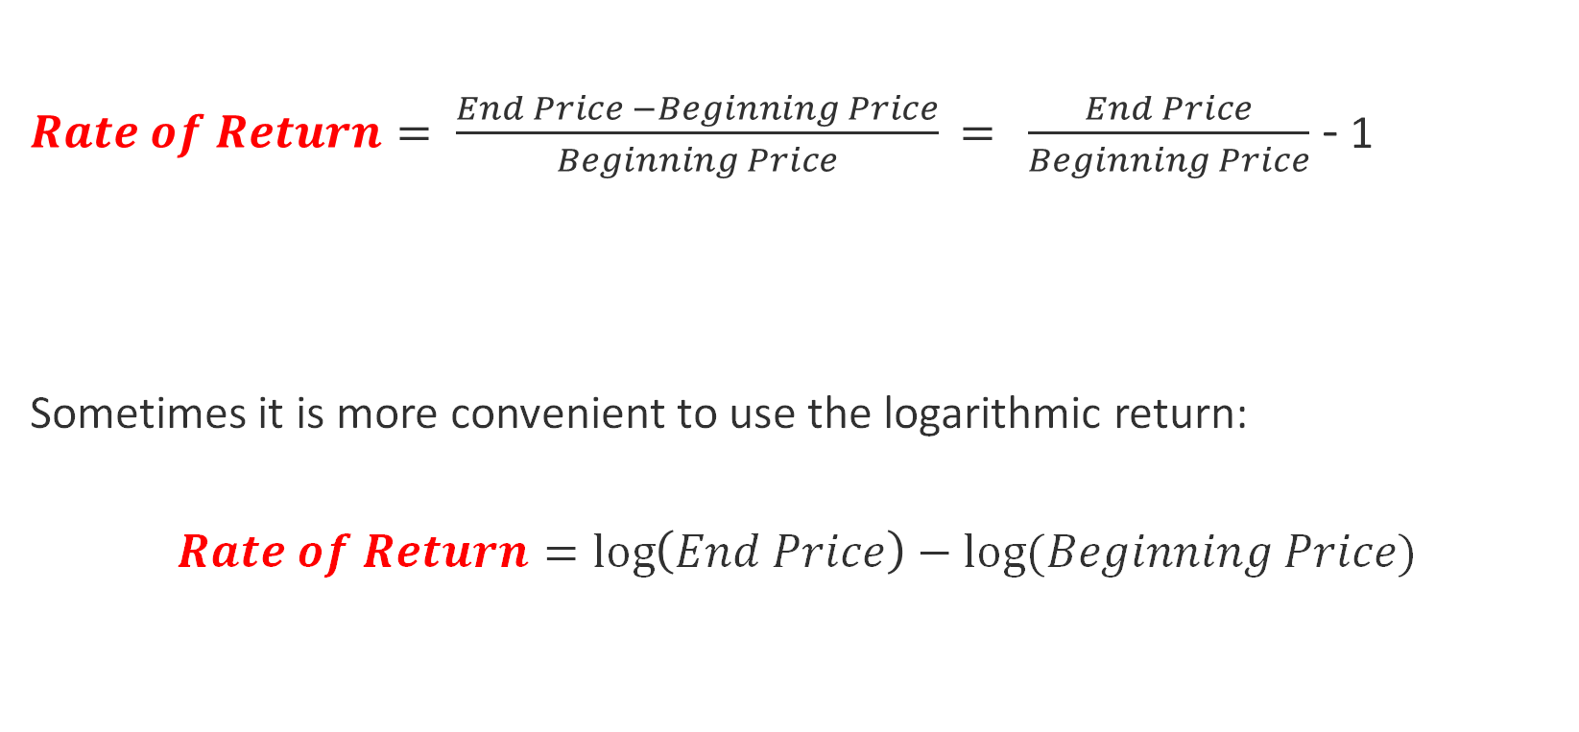
Rate of return on a security
$Rate of Return= \frac{End Price −Beginning Price}{Beginning Price}$ $=$ $\frac{End Price}{Beginning Price}$ - 1
Sometimes it is more convenient to use the logarithmic return:
$$Rate of Return=\log\left(End Price\right)−log⁡(Beginning Price)$$

Slide 4
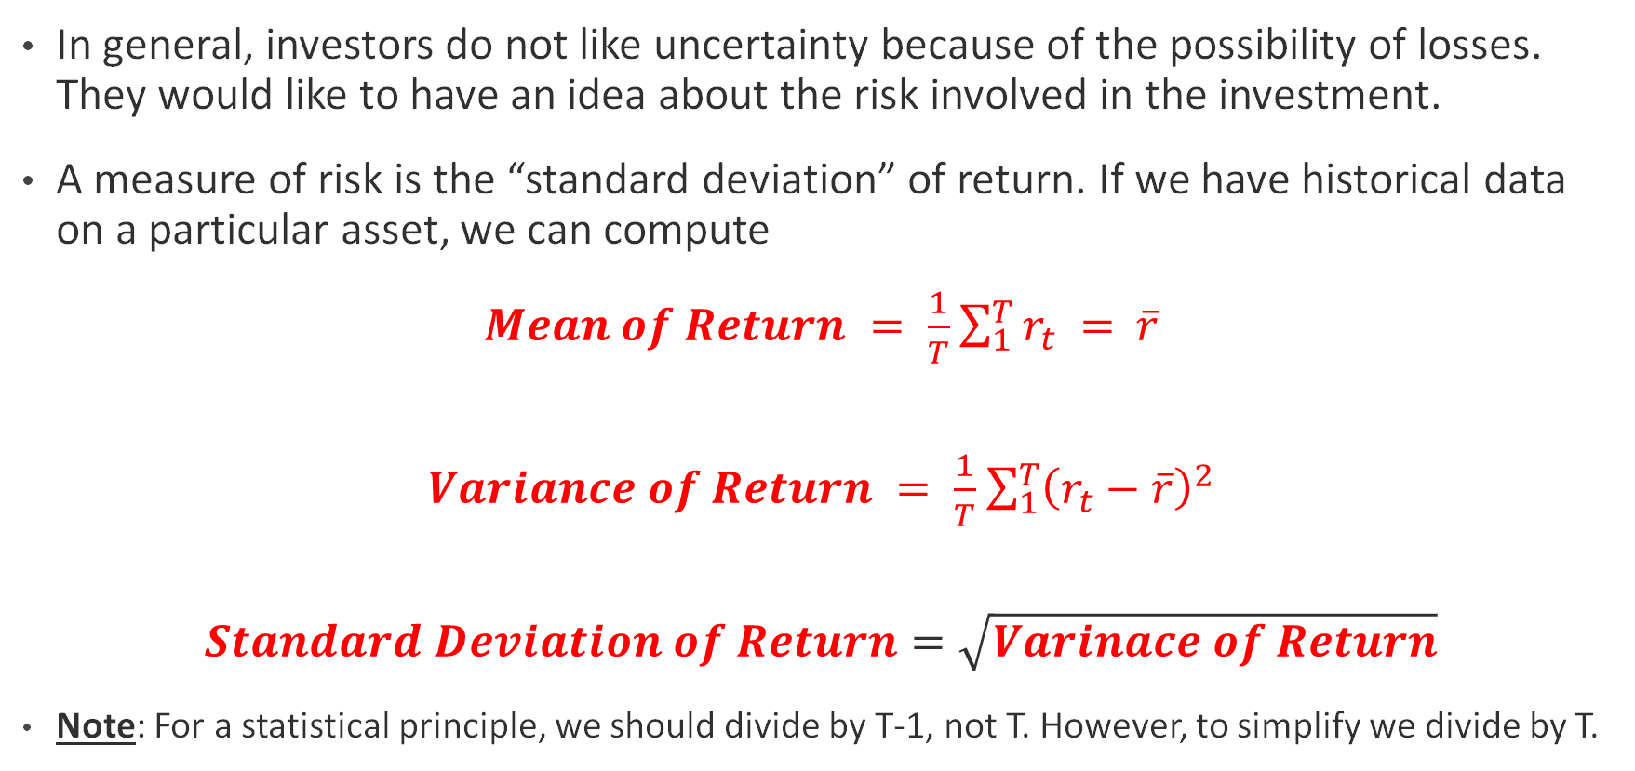
Risk of a security
In general, investors do not like uncertainty because of the possibility of losses. They would like to have an idea about the risk involved in the investment.
A measure of risk is the “standard deviation” of return. If we have historical data on a particular asset, we can compute
$Mean of Return = \frac{1}{T}$ $\sum_{1}^{T}{r_{t}} =$ $\overline{r}$
$Variance of Return = \frac{1}{T}$ $\sum_{1}^{T}{{\left(r_{t}−\overline{r}\right)}^{2}}$
$$Standard Deviation of Return=\sqrt{Varinace of Return}$$
Note: For a statistical principle, we should divide by T-1, not T. However, to simplify we divide by T.

Slide 5
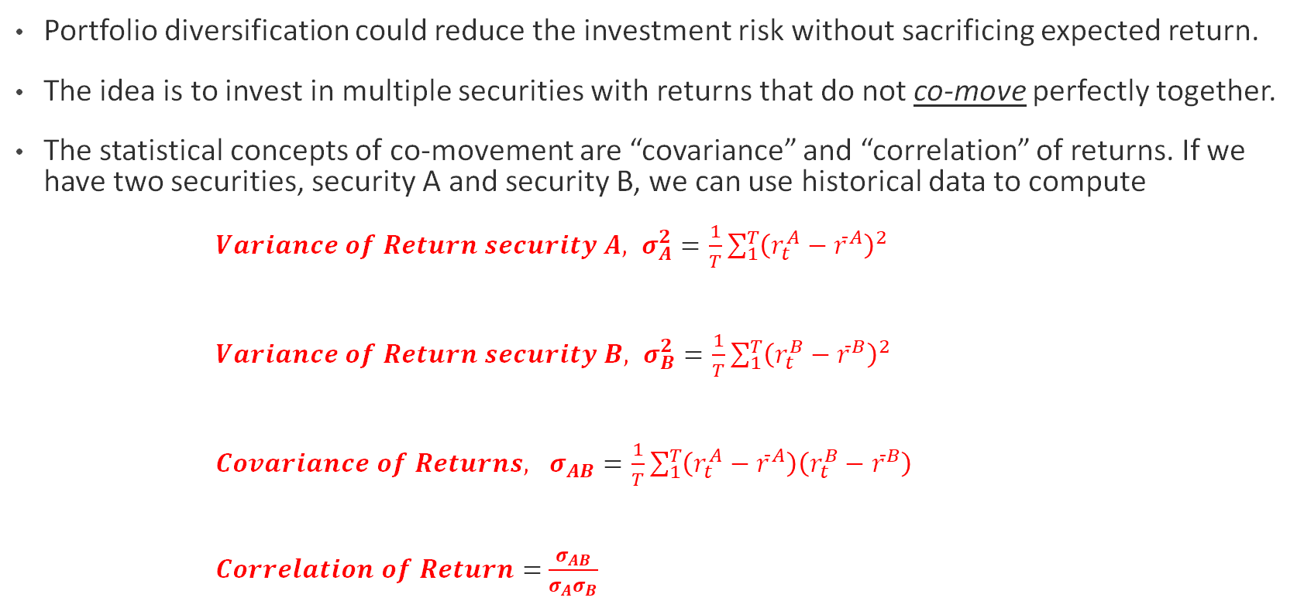
Portfolio diversification
Portfolio diversification could reduce the investment risk without sacrificing expected return.
The idea is to invest in multiple securities with returns that do not co-move perfectly together.
The statistical concepts of co-movement are “covariance” and “correlation” of returns. If we have two securities, security A and security B, we can use historical data to compute
$Variance of Return security A, σ_{A}^{2}=\frac{1}{T}$ $\sum_{1}^{T}{{\left(r_{t}^{A}−{\overline{r}}^{A}\right)}^{2}}$
$Variance of Return security B, σ_{B}^{2}=\frac{1}{T}$ $\sum_{1}^{T}{{\left(r_{t}^{B}−{\overline{r}}^{B}\right)}^{2}}$
$Covariance of Returns, σ_{AB}=\frac{1}{T}$ $\sum_{1}^{T}{\left(r_{t}^{A}−{\overline{r}}^{A}\right)\left(r_{t}^{B}−{\overline{r}}^{B}\right)}$
$Correlation of Return=$ $\frac{σ_{AB}}{σ_{A}σ_{B}}$

Slide 6
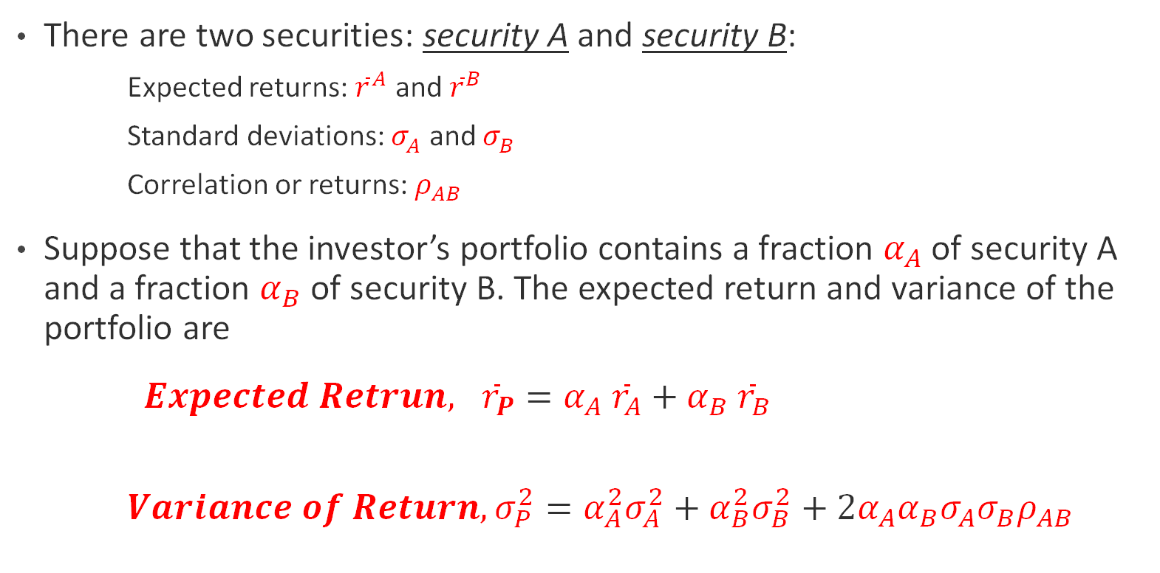
Theory of Portfolio Diversification
There are two securities: security A and security B:
Expected returns: ${\overline{r}}^{A}$ and ${\overline{r}}^{B}$
Standard deviations: $σ_{A}^{ }$ and $σ_{B}^{ }$
Correlation or returns: $ρ_{AB}$
Suppose that the investor’s portfolio contains a fraction $α_{A}$ of security A and a fraction $α_{B}$ of security B. The expected return and variance of the portfolio are
$Expected Retrun, {\overline{r}}_{P}=α_{A} {\overline{r}}_{A}+α_{B} {\overline{r}}_{B}$
$Variance of Return, σ_{P}^{2}=α_{A}^{2}σ_{A}^{2}+α_{B}^{2}σ_{B}^{2}+2α_{A}α_{B}σ_{A}σ_{B}ρ_{AB}$

Slide 7
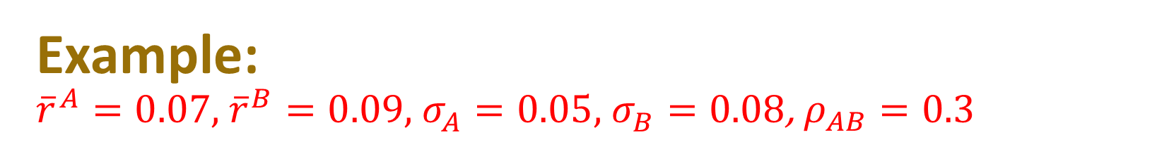
Example: ${\overline{r}}^{A}=0.07,$ ${\overline{r}}^{B}=0.09$, $σ_{A}^{ }=0.05,$ $σ_{B}^{ }=0.08$, $ρ_{AB}=0.3$
Weight A | Weight B | Exp.Return | Std
1.00 | 0.00 | 0.070 | 0.050
0.90 | 0.10 | 0.072 | 0.048
0.80 | 0.20 | 0.074 | 0.047
0.70 | 0.30 | 0.076 | 0.048
0.60 | 0.40 | 0.078 | 0.050
0.50 | 0.50 | 0.080 | 0.053
0.40 | 0.60 | 0.082 | 0.057
0.30 | 0.70 | 0.084 | 0.062
0.20 | 0.80 | 0.086 | 0.068
0.10 | 0.90 | 0.088 | 0.074
0.00 | 1.00 | 0.090 | 0.080

Slide 8
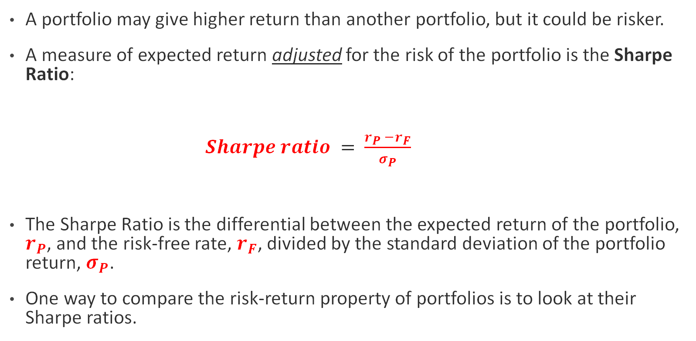
Risk-adjusted return of a portfolio
A portfolio may give higher return than another portfolio, but it could be risker.
A measure of expected return adjusted for the risk of the portfolio is the Sharpe Ratio:
$Sharpe ratio =$ $\frac{r_{P} −r_{F}}{σ_{P}}$
The Sharpe Ratio is the differential between the expected return of the portfolio, $r_{P}$, and the risk-free rate, $r_{F}$, divided by the standard deviation of the portfolio return, $σ_{P}$.
One way to compare the risk-return property of portfolios is to look at their Sharpe ratios.

Slide 9
Application with Python Calculating the Sharpe ratio for cryptocurrencies

Slide 10
The Market Portfolio
A bundle of all possible investments in the world (bonds, stocks, crypto, NFT, etc.)
According to the Capital Asset Price Model (CAPM), the risk-return combination of the market portfolio is superior to any other portfolio.
CAPM key objects:
Market portfolio: just described
Efficient frontier: The (best) combination of all risky investments that gives the highest return for a given risk.
Risk-free asset: An investment with no risk (zero standard deviation of returns). It has positive return but zero risk.
Beta coefficient: It quantifies the relationship between the return of a single security with the return of the overall market portfolio, based on CAPM model.
Capital market line: Line that connects the risk-free rate and the efficient frontier at the tangent point with the frontier. According to CAPM, the point at which the market line is tangent to the efficient frontier is the market portfolio.

Slide 11
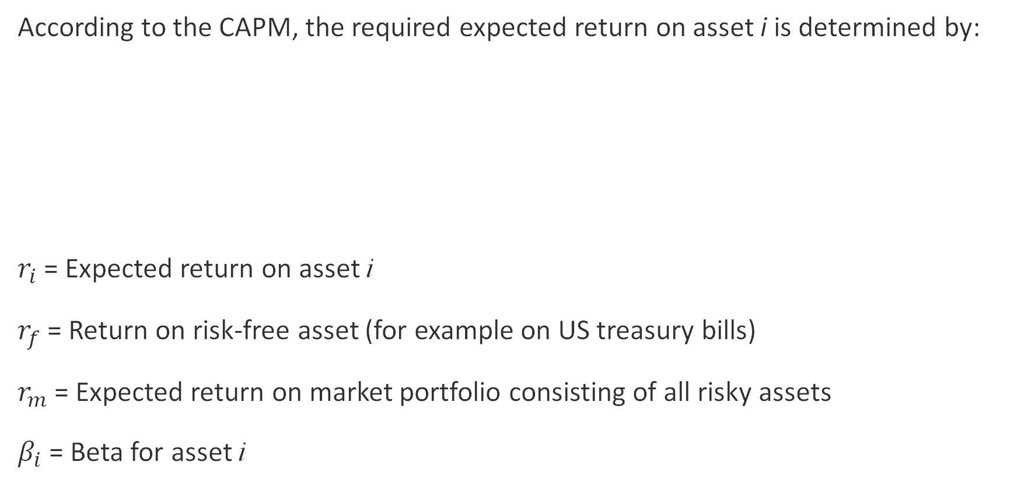
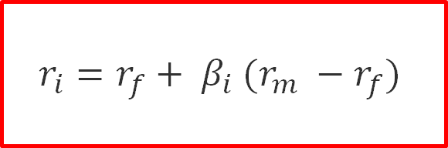
Capital Asset Pricing Model (CAPM)
According to the CAPM, the required expected return on asset i is determined by:
$r_{i}$= Expected return on asset i
$r_{f}$= Return on risk-free asset (for example on US treasury bills)
$r_{m}$= Expected return on market portfolio consisting of all risky assets
$β_{i}$ = Beta for asset i
Risk premium for asset i
$$r_{i}=r_{f}+ β_{i} (r_{m} −r_{f})$$
Market risk premium

Slide 12
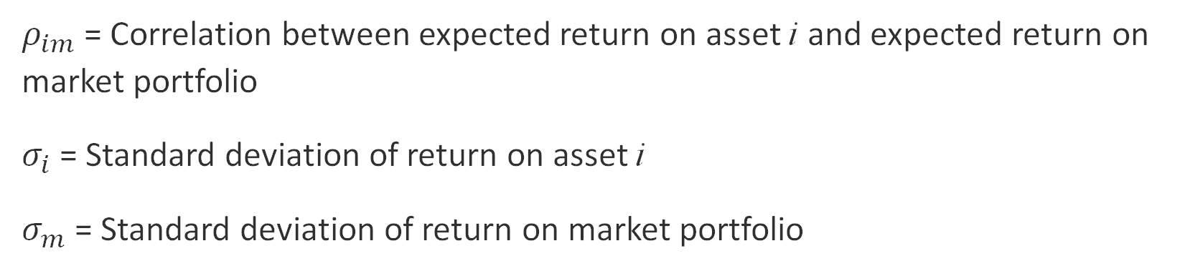

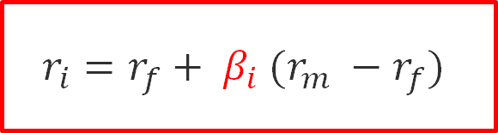
Capital Asset Pricing Model (CAPM)
$$r_{i}=r_{f}+ β_{i} (r_{m} −r_{f})$$
Beta is a measure of the volatility—or systematic risk—of an asset compared to the market as a whole
$$β_{i}= ρ_{im} \frac{σ_{i}}{σ_{m}}$$
$ρ_{im}$= Correlation between expected return on asset i and expected return on market portfolio
$σ_{i}$= Standard deviation of return on asset i
$σ_{m}$= Standard deviation of return on market portfolio

Slide 13
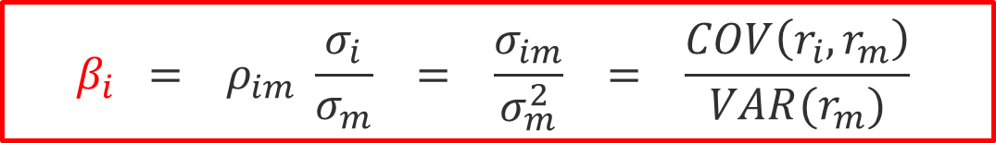
Another way to write the beta
$$β_{i} = ρ_{im} \frac{σ_{i}}{σ_{m}} = \frac{σ_{im}}{σ_{m}^{2}} = \frac{COV\left(r_{i},r_{m}\right)}{VAR(r_{m})}$$

Slide 14
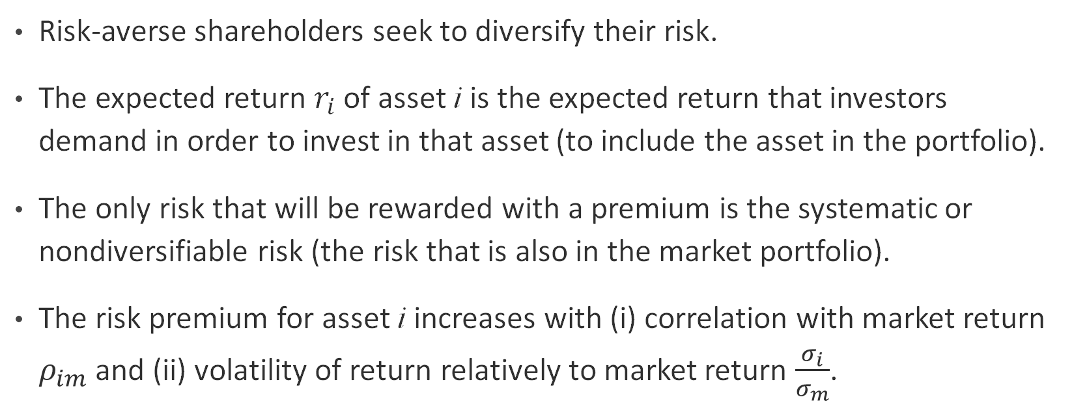

Key assumptions and insights for CAPM
$$r_{i}=r_{f}+ β_{i} (r_{m} −r_{f})$$
$$β_{i}= ρ_{im} \frac{σ_{i}}{σ_{m}}$$
Risk-averse shareholders seek to diversify their risk.
The expected return $r_{i}$ of asset i is the expected return that investors demand in order to invest in that asset (to include the asset in the portfolio).
The only risk that will be rewarded with a premium is the systematic or nondiversifiable risk (the risk that is also in the market portfolio).
The risk premium for asset i increases with (i) correlation with market return $ρ_{im}$ and (ii) volatility of return relatively to market return $\frac{σ_{i}}{σ_{m}}$.

Slide 15
Application with Python Calculating the betas of cryptocurrencies

